Slide 1

Fundamentals of Politics Research Lecture 2 (2020-21) Questions Dr Adrian Blau* * My surname still rhymes with ‘flaw’.

Slide 2
Last time
You are your own educators.
Develop the mindset – and use the language – of an active, critical, sophisticated researcher.
It can take time to develop these skills.

Slide 3
Mindset: key questions
Do I trust the data? Do I trust these intuitions?
How can I test these claims, e.g. objections, counter-examples, or other interpretations?
Am I or these authors trapped by theories?
How confident am I in these findings? How firmly should I present my conclusions? How generalisable are these claims?
Are we even asking all the right questions in the first place?

Slide 4
Today
1. Studying politics at university: eight tips | 7. Facts and values
2. Questions | 8. Him and hers
3. Answers | 9. Subject and object
4. A science of politics? | 10. Concepts
5. Quantitative and qualitative | 11. Bullshit
6. Reading week | 12. Recap: ethical scholarship
asdasdasd
What we do

Slide 5
Today
The ‘so what?’ question; creativity.
Four key questions: the DEEP framework.
Seminar: applying the DEEP framework to three short articles (which can also help you for the formative essay!).
Remember: new Discussion Forum rules, from this week onwards.

Slide 6
So what?
Does this really matter? What is actually important here?
Does a planned or actual piece of research focus on the most important questions?
To the extent that it does not, should we ...
ask different questions?
choose different cases?
use different methods/approaches?
etc.

Slide 7
DEEP political science
Describe | What happens. | How does turnout vary among different ethnic minority groups?
Explain | Why it happens. | What explains this? Does it affect policy?
Evaluate | Whether what happens is good. | Does this matter?
Prescribe | What should change to make it better. | What should we do to increase/equalise turnout among these groups?

Slide 8
DEEP political theory
Describe | What happens. | What are Rawls’s explicit and implicit assumptions about gender?
Explain | Why it happens. | Why does he make these assumptions? Do they affect his broader theory?
Evaluate | Whether what happens is good. | Are his assumptions plausible? Do they weaken his liberalism?
Prescribe | What should change to make it better. | If we change his assumptions, would it still be Rawlsian, or liberal?

Slide 9
Exercise 1
Apply the DEEP framework to Brexit. Think up TWO questions for each category.
Describe | What happens.
Explain | Why it happens.
Evaluate | Whether what happens is good.
Prescribe | What should change to make it better.

Slide 10
Exciting technological advance
Semi-intelligent multiple-choice quiz on KEATS as part of your seminar preparation.
Funded by DPE. Prepared by Dr Elizabeth Ralph-Morrow & me.
>1 of (a) to (e) may be right.
Tell your seminar tutors or comment on the new Forum.
We can see who has done it!

Slide 11
Description / descriptive inference
Inference: ‘using observations from the world to learn about other unobserved facts’ (King, Keohane and Verba 1994, 8). Henceforth KKV.
All empirical inferences are guesses – but there are better and worse guesses, and better and worse ways of guessing.
KKV’s dichotomy is a false dichotomy.
description descriptive inference
All political ‘descriptions’ are inferences – often several inferences.
It helps to remind ourselves just how indirect.

Slide 12
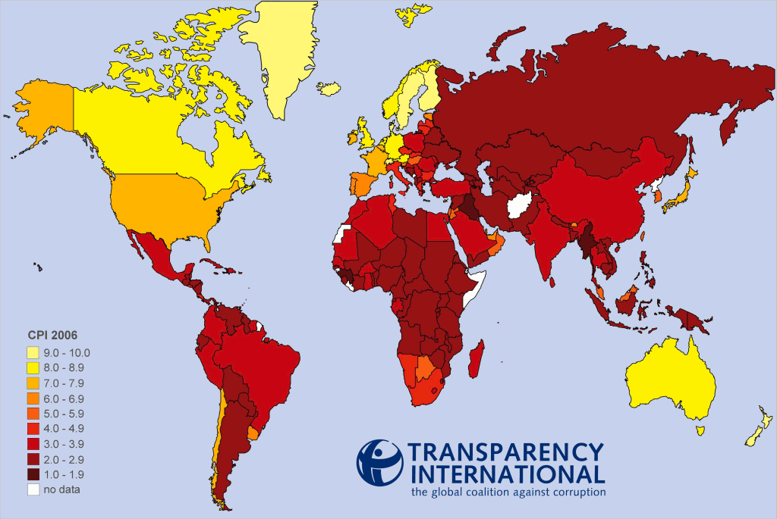
Example: the Corruption Perceptions Index
See also De Maria (2008) on KEATS.

Slide 13
Explanation
Explanation: finding causes, showing outcomes.
All explanations are inferences. (‘Explanation’ and ‘explanatory inference’ are equivalent.)
Four scary facts about causes:
We can never see a cause.
We can never prove inferences about causes.
There are many ideas of what a ‘cause’ is.
None of these ideas works.

Slide 14
Beyond explanation
‘Social science research, whether quantitative or qualitative, involves the dual goals of describing and explaining’ (KKV 1994, 34).
Explanation is ‘[t]he main task of the social sciences’ (Elster 2007, 9).
Kellstedt and Whitten (section 1.2): explanation is what makes social science a science.
KKV mention political theory e.g. obligation and legitimacy (1994, 6). But there’s a middle ground!

Slide 15
Evaluation
These are all normative concepts.
How democratic is the US constitution?
Is Russia authoritarian?
Was the Sydney Opera House a policy failure?
Is first-past-the-post broken?
Was George W. Bush a terrorist?
How efficient is the EU bureaucracy?
Is low turnout a problem for democracy?
➔ Conceptual and empirical (descriptive and/or explanatory).
There are other concepts here too e.g. ‘is’ and ‘Russia’!

Slide 16
Evaluation
Non-normative evaluation:
Is France a presidential system?
Does the UK have a two-party system?
Is politics being judicialized and/or juridified?
All of the above can also be normative, if you see these concepts as good/bad.
classification: pointless?

Slide 17
If you’re confused
Evaluation always has two parts:
conceptual
empirical
When the concept is normative, the evaluation is normative.
When the concept is non-normative, the evaluation is non-normative.

Slide 18
Prescription
How could/should the US constitution be made more (or less) democratic?
How might Russia be made more (or less) authoritarian?
How could France be made more (or less) presidential?
(Can involve the past – e.g. how should the Framers of the US Constitution have made it more democratic?)

Slide 19
➔ Creativity
‘Thinking outside the box’ is important for many researchers – but can be risky for students!
3 tips for essays:
Start thinking about the title early.
Read widely and critically.
If in doubt, check with module convenor or seminar leader.

Slide 20
Exercise 2
Think creatively about the following essay title:
‘What explains the rise of corruption in the UK?’
N.B. You don’t have to be creative to get high marks in essays!
Creativity can be risky. (CPS, Intro: 3/4 marks.)

Slide 21
⬅ DEEP social science
Social science can be about more than just description and explanation: norms matter.
Much description and explanation is ultimately aimed at contributing to normative questions.
Good evaluation depends on good description and (sometimes) good explanation.
Good evaluation also requires clear concepts.
Evaluations have an ‘if–then’ structure.
Social scientists believe there are right answers to DEEP questions.

Slide 22
Extra points
Prediction is explanation run forwards in time.
Conceptual analysis is not itself included.
What is ‘democracy’? What is ‘policy failure’?
Some ‘political theory’ is also covered by DEEP.
Two fears:
Are all explanations really evaluations?
Are all descriptions really evaluations?

Slide 23
Example: Duverger’s law (1964)
Huge literature on whether proportional representation leads to multi-party systems.
So what?
Kellstedt and Whitten (2009, section 3.3.3): this is what political scientists do.
Blau (2007): no, political scientists can do more.
Accountability, stability, representativeness, etc.
(K+W: Weimar Germany, disproportionality in US elections! Section 3.4: alcoholism, breast cancer. Not just about getting the right explanations!)

Slide 24
Example: turnout
We know lots about causes of differential turnout.
We know much less about the extent to which differential turnout affects policy output.
Evaluations may depend on explanations:
e.g. Mark Franklin (2004): declining turnout is primarily associated with changes in the age of voting.
Prescriptions may depend on explanations:
Lower voting age to 16? (Find out more about the conditions under which this would reduce turnout.)

Slide 25
Conclusions
All descriptions and explanations are inferences.
There’s more to social science than description and explanation. Norms matter!
Learning how to ask the right questions is incredibly important. Creativity is crucial!
This helps you to be constructively critical and write better essays.

